Slide 1
Search and Decoding in SR Final Project
William (Austin) Gay

Slide 2
Project
Text Pre-Processing
Create N-grams model
Use N-gram smoothing
Apply Beam Search
Practical application of N-gram model
Using Python

Slide 3
Data
Text data obtained from Wikipedia articles online
Preprocessing
Convert everything to lowercase
Use Regular Expression to remove all character except letters, periods, and spaces
Add <s> (BOS) and </s> (EOS) markers to sentences
Tokenize text data

Slide 4
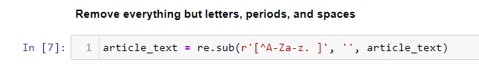
Data

Slide 5
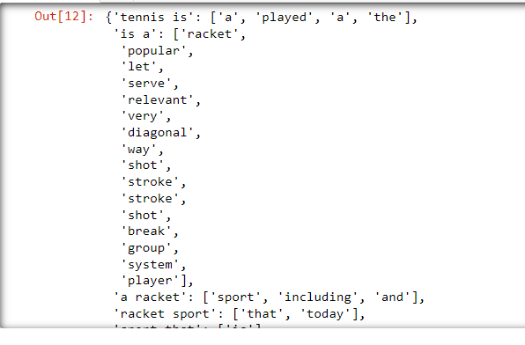
N-gram creation
Create N-gram

Slide 6
Sentence Generation
Generate a sentence using N-gram, output size, and initial input
Uses random function to select random N-gram based on sequence, equivalent to using probabilities
Using input ‘baseball is a’ with Trigram model
baseball is a batandball sport played between two teams each usually composed of nine players </s>the number of players on a baseball roster or squad varies by league and by the level of organized play two coaches are stationed on the field to confer with players during a game </s>any baseball game involves
computer science departments with a mathematical discipline argue that while empirical sciences observe what presently exists computer science and software engineering is a contentious issue which is further muddied by disputes over what the term computing science to emphasize precisely that difference EOS BOS BOS computer science predate the invention of the

Slide 7
Increasing N-gram size and generating sentence
Quadrigram
Input: ‘baseball is a’
baseball is a mandatory part of the state system of physical education departments at most high schools and colleges in the united states though in modern times is considered less popular than other sports such as american football </s> <s> <s> a player bats at home plate and the outfield boundary is the
computer science departments with a mathematics emphasis and with a numerical orientation consider alignment with computational science EOS BOS BOS BOS but the automation of evaluative and predictive tasks has been increasingly successful as a substitute for human monitoring and intervention in domains of computer application involving complex realworld data EOS computer graphics

Slide 8

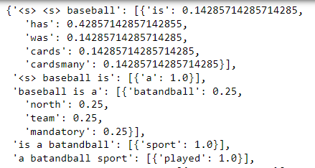
Calculating Probabilities
Count occurrences of each N-gram and divide by occurrences of preceding Bi-gram
Calculate Probabilities for each Trigram

Slide 9
Sentence Generation using probabilities
Sentence generated using:
Input = ‘baseball is’
Length = 50
Choosing Tri-gram with highest probability
Calculated Sentence Probability:
Calculated Perplexity
baseball is a batandball sport played between two teams of nine players each taking turns batting and fielding </s> <s> <s> the first officially recorded baseball game in the united states and canada teams are divided into the field of play is similarly split in japan south korea and taiwan </s>in major
4.255656569198485e-14
1.8510607347827526

Slide 10
Sentence Generation using probabilities
Sentence generated using:
Input = ‘baseball is’
Length = 50
Choosing Quad-gram with highest probability
Calculated Sentence Probability:
Calculated Perplexity
theoretical computer science and software engineering focuses on the design and implementation of hardware and software EOS BOS BOS BOS the term is used mainly in the scandinavian countries EOS BOS BOS BOS the term is used mainly in the scandinavian countries EOS BOS BOS BOS the term is used mainly in the
4.3359066418944166e-09
1.4698005364282294

Slide 11
Add One N-gram smoothing
Add one to each of the counts
Input: ‘baseball is’
Length = 50
Calculated Sentence Probability:
Calculated Perplexity:
baseball is a batandball sport played between two teams of nine players each taking turns batting and fielding </s> <s> <s> the first officially recorded baseball game in the united states and canada teams are divided into the field of play is similarly split in japan south korea and taiwan </s>in major
9.350538498023945e-16
1.9979437987117061

Slide 12
Add One N-gram smoothing
Add one to each of the counts
Input: ‘baseball is’
Length = 50
Calculated Sentence Probability:
Calculated Perplexity:
baseball is a batandball sport played between two teams of nine players each taking turns batting and fielding </s> <s> <s> the first officially recorded baseball game in the united states and canada teams are divided into the field of play is similarly split in japan south korea and taiwan </s>in major
9.350538498023945e-16
1.9979437987117061

Slide 13
Add One N-gram smoothing
Add one to each of the counts
Input: ‘baseball is’
Length = 50
Calculated Sentence Probability:
Calculated Perplexity:
theory of computation information theory and automation to practical disciplines including the design and implementation of hardware and software EOS BOS BOS BOS the term is used mainly in the scandinavian countries EOS BOS BOS BOS the term is used mainly in the scandinavian countries EOS BOS BOS BOS the term is used
2.7848091489247936e-09
1.4828734561551005

Slide 14
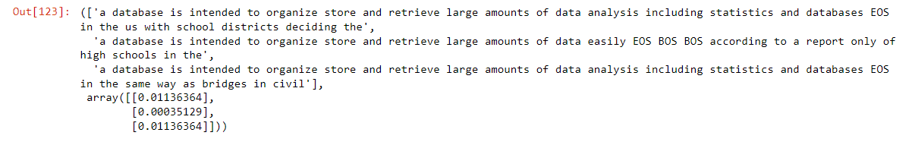
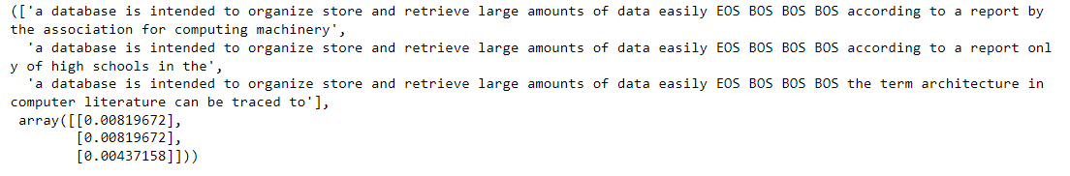
Beam Search
Used beam search algorithm to search for most likely sentence given beginning of sentence.
Trigram
Quadgram

Slide 15
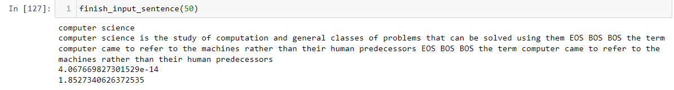
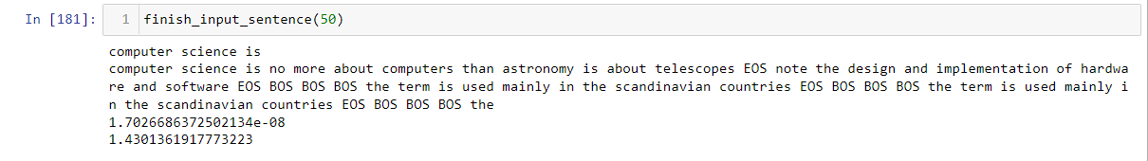
User input
Created function to take in user input and complete sentence

